Slide 1
From faculty to higher ed administration A Taiwanese mathematician's journey Ben Weng

Slide 2
Disclaimer
Ben is “endlessly optimistic”, so please take the following presentation with a grain of salt…

Slide 3
A chronicle of Ben’s time in the US
Permanent residency (green card) awarded
Sep. 11, 2001
Recession
1998
2005
2008
2013
2014
2015
2018
Wife and first child
Second child
Tenured
Third child
Hello America and U of M!
Joined Metro State
Promoted
Graduated.
Moved to NJ for first tenure-track job.
Math Department Chair
STEM Dean at
Minneapolis College

Slide 4
What’s a dean? An administrator or a manager?
Both, but much more. I prefer the term academic leader.
Administrators are for those who need their services administered.
Managers are for those who need to managed.
Leaders are for groups (of professionals) who aspire to accomplish something together.

Slide 5
What do deans do?
Ben does all kinds of everything OUTSIDE of the classroom.
Management. Budget. Employees. Policies and procedures.
Programming. Departments and programs.
Collaboration. Transfer partners. Industry partners. SA. ARC. Registrar. Advisors. Career Services. K-12 districts. Etc.
Outreach. Local and national organizations.
Missions and strategic goals.

Slide 6
Ben’s evolution on the job
And how he considers his deanship…
2017-2018. Providing a valuable service. (Manager)
2018-2021. Building a great team and leading it. (Leader)
Example: Quick conversion and adaptation during COVID.
2021-2024. Pursuing goals with the resources I don’t possess as faculty. (Visionary)
Example: The creation of Math for Social Justice course.

Slide 7
Ten Challenges for Deans of Color
(List generated by AI)
Underrepresentation
Stereotyping and Bias
Navigating Institutional Politics
Mentorship and Networking
Managing Diversity and Inclusion Initiatives
Microaggressions and Discrimination
Balancing Personal and Professional Identities
Addressing Equity and Access
Self-Care and Wellbeing
Intersectionality

Slide 8
Ten Challenges for Deans of Color
(List generated by AI)
Underrepresentation
Stereotyping and Bias
Navigating Institutional Politics
Mentorship and Networking
Managing Diversity and Inclusion Initiatives
Microaggressions and Discrimination
Balancing Personal and Professional Identities
Addressing Equity and Access
Self-Care and Wellbeing
Intersectionality

Slide 9
Ten Challenges for Deans of Color
(List generated by AI)
Underrepresentation
Stereotyping and Bias
Navigating Institutional Politics
Mentorship and Networking
Managing Diversity and Inclusion Initiatives
Microaggressions and Discrimination
Balancing Personal and Professional Identities
Addressing Equity and Access
Self-Care and Wellbeing
Intersectionality

Slide 10
Ten Challenges for Deans of Color
(List generated by AI)
Underrepresentation
Stereotyping and Bias
Navigating Institutional Politics
Mentorship and Networking
Managing Diversity and Inclusion Initiatives
Microaggressions and Discrimination
Balancing Personal and Professional Identities
Addressing Equity and Access
Self-Care and Wellbeing
Intersectionality

Slide 11
Ten Challenges for Deans of Color
(List generated by AI)
Underrepresentation
Stereotyping and Bias
Navigating Institutional Politics
Mentorship and Networking
Managing Diversity and Inclusion Initiatives
Microaggressions and Discrimination
Balancing Personal and Professional Identities
Addressing Equity and Access
Self-Care and Wellbeing
Intersectionality

Slide 12
Ten Challenges for Deans of Color
(List generated by AI)
Underrepresentation
Stereotyping and Bias
Navigating Institutional Politics
Mentorship and Networking
Managing Diversity and Inclusion Initiatives
Microaggressions and Discrimination
Balancing Personal and Professional Identities
Addressing Equity and Access
Self-Care and Wellbeing
Intersectionality

Slide 13
Ten Challenges for Deans of Color
(List generated by AI)
Underrepresentation
Stereotyping and Bias
Navigating Institutional Politics
Mentorship and Networking
Managing Diversity and Inclusion Initiatives
Microaggressions and Discrimination
Balancing Personal and Professional Identities
Addressing Equity and Access
Self-Care and Wellbeing
Intersectionality

Slide 14
Ten Challenges for Deans of Color
(List generated by AI)
Underrepresentation
Stereotyping and Bias
Navigating Institutional Politics
Mentorship and Networking
Managing Diversity and Inclusion Initiatives
Microaggressions and Discrimination
Balancing Personal and Professional Identities
Addressing Equity and Access
Self-Care and Wellbeing
Intersectionality

Slide 15
Want to be in admin?
Test your ability by being a department chair.
Leadership training opportunities.
Mentors.
Read the job postings!
For example, http://www.HigherEdJobs.com
Consider moving to another institution.
Do you want to manage your old colleagues as their boss?
Know your IFO contract rights.

Slide 16
Conclusion
Being an academic leader is fulfilling if you can…
manage,
lead, and
find satisfaction and purpose.
Challenges? They are solvable and your career is worth the effort.

Slide 17
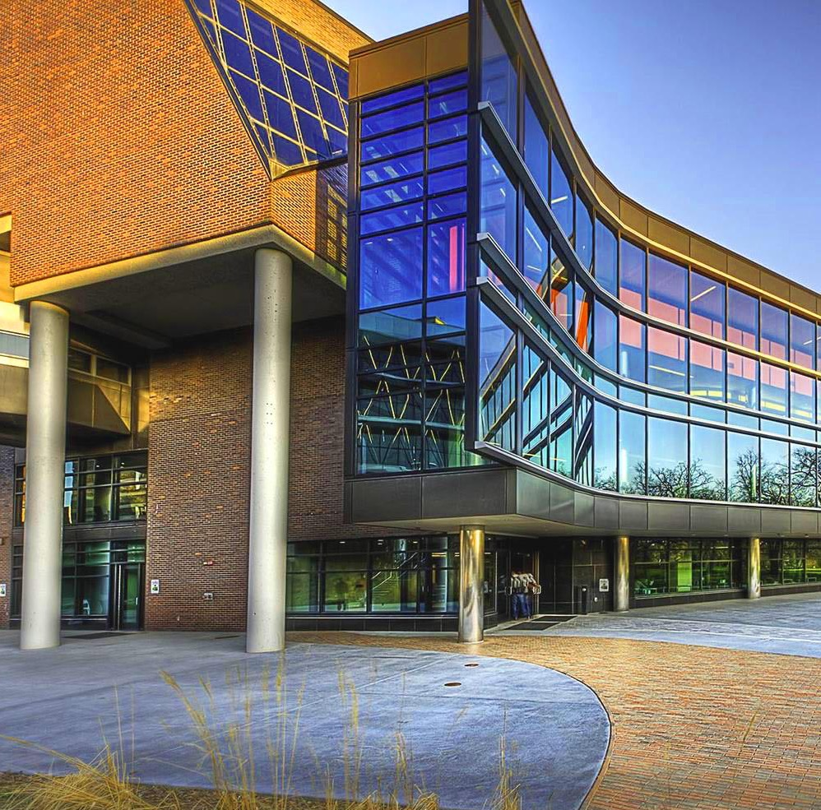
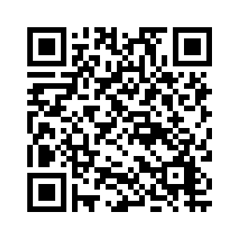
Thank You
Ben.weng@minneapolis.edu
Download the PPT presentation at:

